Slide 1



WoT ontology development & current status (v0.0.6)
María Poveda Villalón
Fernando Serena
Raúl García Castro
Ontology Engineering Group
Universidad Politécnica de Madrid
mpoveda@fi.upm.es
@MariaPovedaV
17st May, 2017
Osaka F2F (remote)

Slide 2
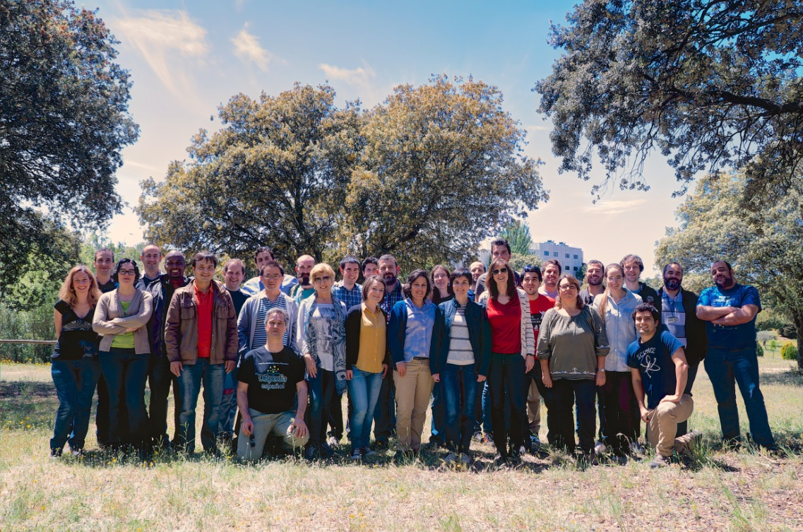

Ontology Engineering Group
Created in1995
Directors: A. Gómez-Pérez, O. Corcho
Position: 8th in the UPM ranking (200 groups)
Research Group (30 people)
2 Full Professors
5 Associate Professors
3 Assistant Professors
7 Senior Postdocs
6 PhD Students
2 MSc and BSc Students
2 software engineers
1 system administrator
2 project managers
170+ Past Collaborators
50+ Past Visitors
http://www.oeg-upm.net/
https://github.com/oeg-upm
@oeg-upm

Slide 3

Ontology Engineering Group
Created in1995
World-wide known in the research areas
Ontologies
Semantic Web and Linked Data
Multilingual linked Data
Open Data
eScience
Projects (> 12M€)
27 EU projects (7 as coordinator)
54 National Projects
27 contracts with companies
Awards: SUR IBM Watson
Publications
106 journals
362 International conferences and book chapters
7 Books
Impact of publications H-index
Asunción Gómez-Pérez (h:50, citations 15025)
Oscar Corcho García (h: 36, citations 8258)
Services to the Spanish community
Host esDbpedia
Host linkeddata.es
Awards and Prizes
Ada Byron, Fujitsu, Open data, ISWC
SUR Awards Watson for Tech. Watch
Supervision of students
28 Ph.D thesis (9 awarded best thesis prize)
>150 MS.C thesis and BS.C
Events organization
11 editions of the International Summer School on Ontological Engineering and the Semantic Web
> 50 WS and tutorials
Standardization activities
>25 @ W3C, ISO, OASIS, AENOR, etc.
Mobility
PhD students: 3-6 months abroad
Postdocs: 1 month every 2 years
Visibility
Program chairs of ESWC, ISWC, KCAP, EKAW, TKE, TIA
Editorial board of Journals
Invited talks at conferences and events
Programme Committee presence
Collaboration with COM (Center Open Middleware)
Notes:
One of the european project we work in is VICINITY

Slide 4
VICINITY - vision and Objectives
http://vicinity2020.eu/
VICINTY’s vision is to
provide “Interoperability” as a service
create a platform for domain-crossing, value-added services
by building and demonstrating a
bottom-up ecosystem of decentralised interoperability of IoT infrastructures called virtual neighbourhood,
like social network for things, enabling value added services
where users can share the access to their smart objects without losing the control over them
where x-domain services and buisiness models can be established

Slide 5
VICINITY ontology network
WoT ontology
Notes:
Therefore we started looking at definitions of Web of Things

Slide 6




Ontology development process overview
Openly managed in GitHub
Openly reported in GitHub issue tracker: new needs, bugs, etc.
Ont. Devel.
Users
Experts
Ont. Devel.
Ont. Devel.
Ont. Devel.
Users
Experts
Ontological requirements specification
Ontology implementation
Ontology Publication
Ontology maintenance
Competency questions
Ontology
Online ontology
Issue tracker
Shared in online spreadsheets
snapshot in documentation
Legend
Actor
Activity
Output
activity flow
Ontology code and documentation available online
Slide 6

Slide 7
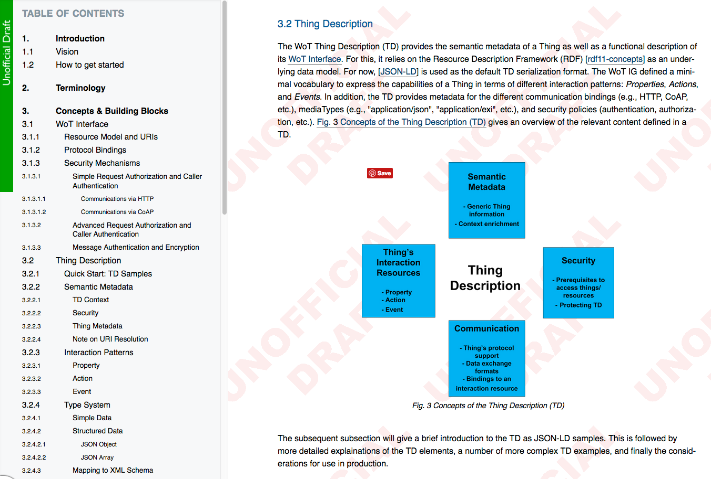
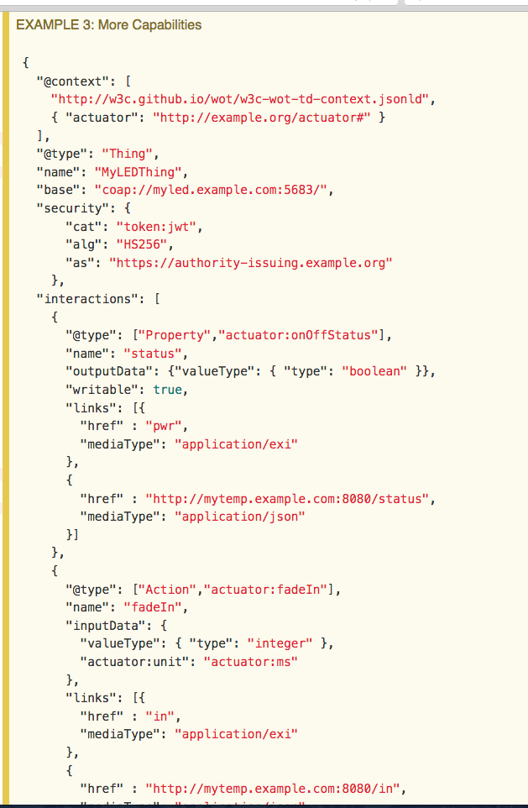
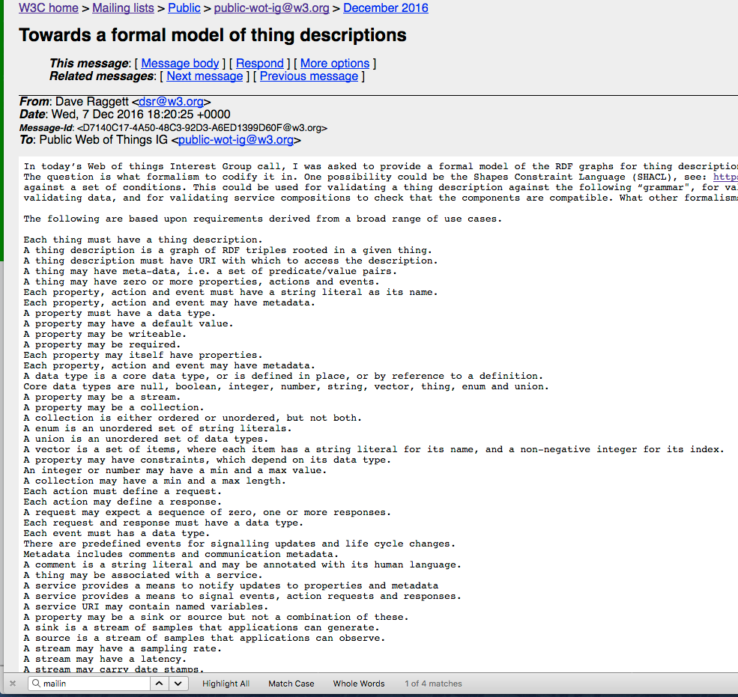
Requirements from WoT WG
http://w3c.github.io/wot/current-practices/wot-practices
https://lists.w3.org/Archives/Public/public-wot-ig/2016Dec/0016.html

Slide 8
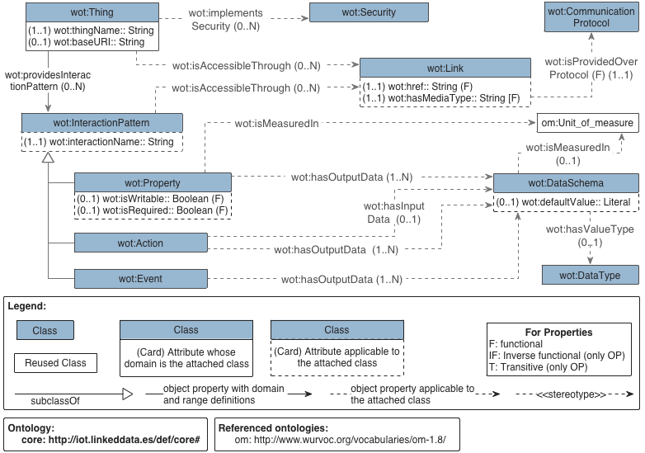
WoT ontology 0.0.6

Slide 9
Example

Slide 10
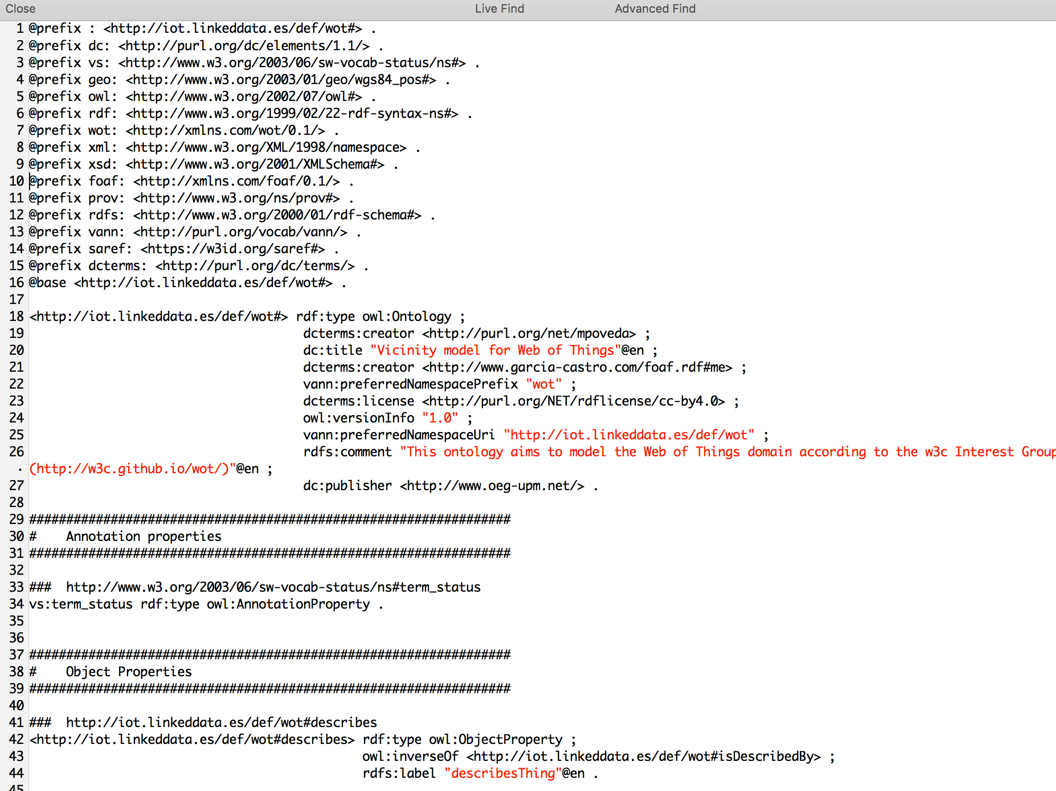
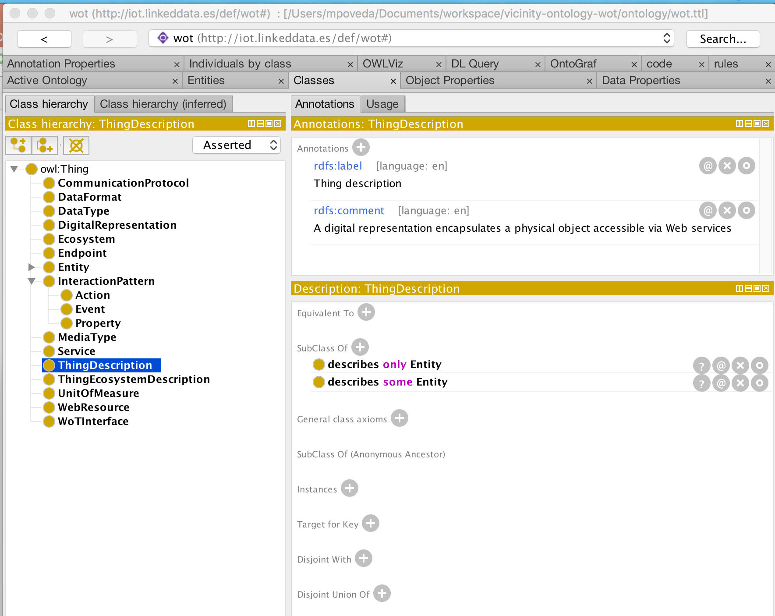
WoT Ontology implementation
Output:
Ontology code
Tool:
Ontology editor
Tool: GitHub repository
https://github.com/mariapoveda/vicinity-ontology-wot
Slide 10

Slide 11
WoT ontology publication (so far)
http://iot.linkeddata.es/def/wot/
No project dependencies. Proposal: http://www.w3.org/ns/td#
Output:
Human oriented documentation
Ontology code
Output:
Machine oriented code

Slide 12
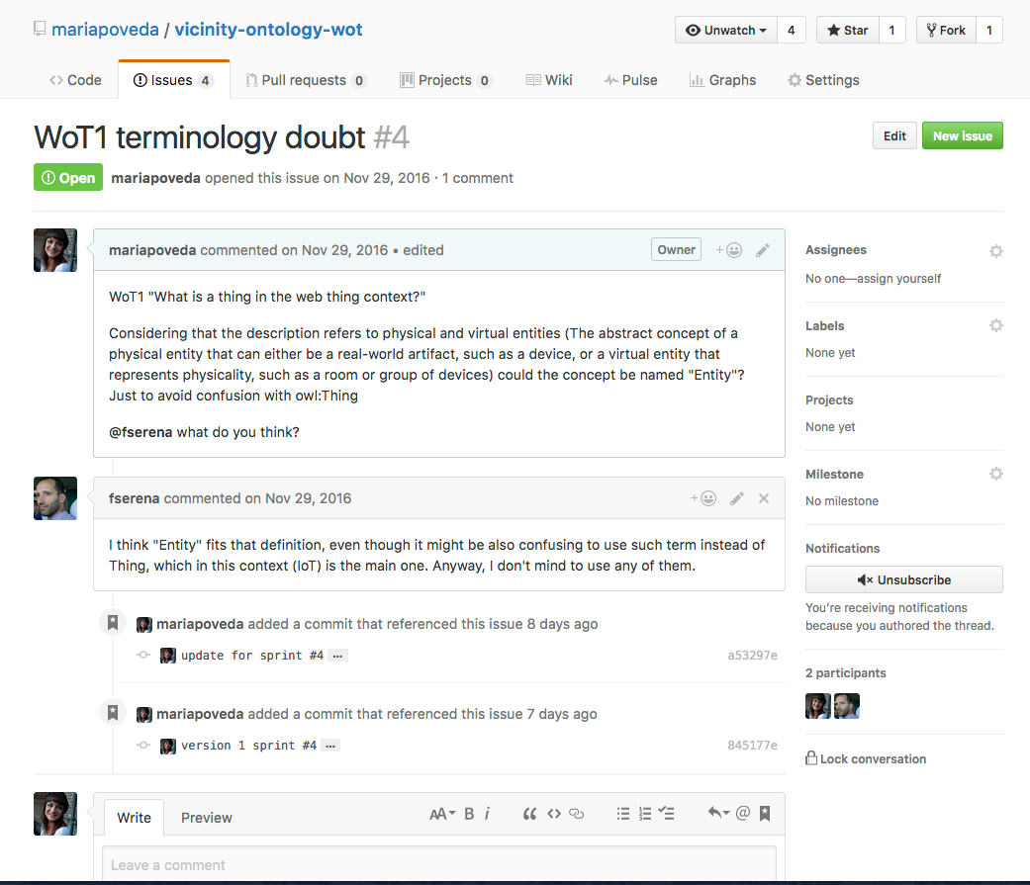
Issue tracker
Tool: GitHub issue tracker
https://github.com/mariapoveda/vicinity-ontology-wot

Slide 13
WoT evolution
Done
Remove
Physical thing, Virtual thing, Relative endpoint, Thing description ecosystem (VICINITY concept),
Rename
Data schema (data format), Link (endpoint),
Add
Security (not described yet)
Changed model
Default value (Property → DataSchema), Media type (concept → datatype), added cardinalities
Next steps: Currently discussing
Need of communication protocol?
Model types?
Coupling IG JSON model with ontology conceptual model?
Rename properties?
Not following OE good practices vs space reducing in TD?
Security

Slide 14
Questions?
Thanks for you attention

Slide 15
WoT ontology development & current status (v0.0.6)
María Poveda Villalón
Fernando Serena
Raúl García Castro
Ontology Engineering Group
Universidad Politécnica de Madrid
mpoveda@fi.upm.es
@MariaPovedaV
17st May, 2017
Osaka F2F (remote)

